Slide 1
COS 432: Information Security Passwords & Authenticating People
Nick Feamster Princeton University

Slide 2
Steps in a Typical Web Session
Authenticate the server (PKI)
Set up an encrypted session (Key exchange)
Start communicating securely (Sym. enc, MAC)
Authenticate the user (e.g., passwords)
Asymmetric encryption not needed
#2 could be before #1 (or combined)
#1–3 handled by transport layer, #4 by app. layer
Notes:
(Asymmetric encryption could be a component of key exchange, e.g., RSA-KE, but it’s not directly needed.)
Encryption is a technological problem. Basically solved. Authentication is a part-human and part technological-problem.
In this list, user authentication is the source of most real-world security failures, followed by server authentication.

Slide 3
Things We Log Into
Web sites
Email
Devices
Doors
Cars
…

Slide 4
Authentication in Everyday Life
Notes:
Authentication is all around us. Not always technological. Different threat models and security-usability trade-offs.
Thought experiment 1: think of all the ways to authenticate that you carry around on your person.
Thought experiment 2: think about how you authenticate yourself in various real-world scenarios: getting on a plane, renting a car, checking into a hotel, claiming your reservation at a restaurant or other venue, entering a bar, entering a locked room/office/building, entering a building with an authentication check --- library, courthouse, other office building, getting into an uber, taking transit, calling your bank, paying by credit card, withdrawing cash at an ATM, filing your taxes.

Slide 5
Three Ways to Authenticate
Something you know
password, security questions, …
Something you have
physical key, security badge, …
Something you are
biometrics, typing cadence, …

Slide 6
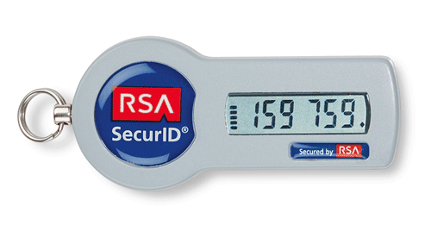

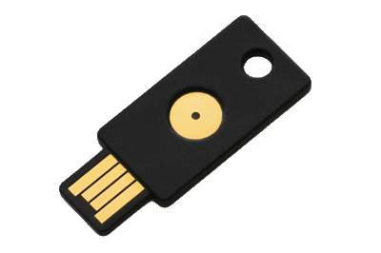
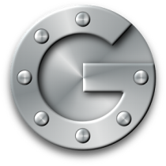

Something You Have
Physical (hardware) token
RSA token
Yubikey
Smartphone?
Common Protocols
HOTP: (HMAC(K,C) & 0x7FFFFFFF) mod 10^{d}
TOTP: HOTP, where C = (now - T₀) / T_{step}

Slide 7
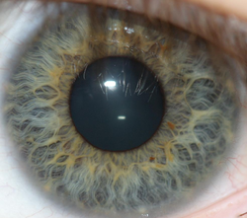
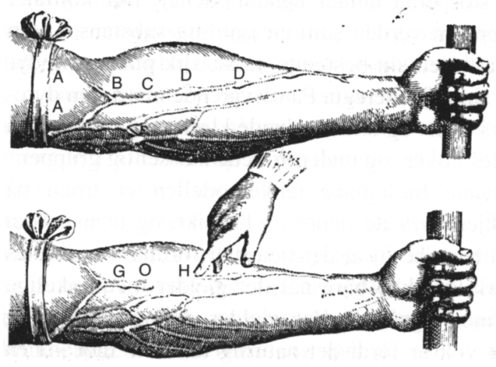
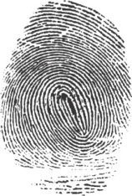
Something You Are
Biometrics
Hopefully unique to you
Disadvantages?
Challenges?
Notes:
Doesn’t change, can’t get a new iris or fingerprint if yours is compromised
Not an exact match, have to handle noisy data…
Touch-ID hack:
https://vimeo.com/75324765

Slide 8
Common Authentication Strings
Password
PIN
Credit card number
Social security number
Security questions
Phone number (e.g., supermarket loyalty program)
Notes:
Each of these differs from a password in some subtle ways
e.g., SSN not intended to be authentication string, but now used that way
Phone number: same string acts as user identifier and passcode (very low security, but it’s ok for a supermarket loyalty program)
SSN and phone #: can’t be easily changed. If adversary learns your SSN or phone # you can’t undo that.

Slide 9
Passwords / Passphrases
Short, usually memorized string used for authentication

Slide 10
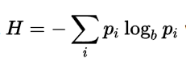
Passwords / Passphrases
Low entropy compared to cryptographic key
Random word from 30,000-word vocab? 15 bits
Random word from English text? 10 bits
e.g., turn to random page of book, pick random word
Thought Question: verify this
Typical web password: 20–25 bits
Shannon Entropy:
Notes:
If an authentication string has k bits of entropy it will take adversary 2^k guesses on average to get in.
Here we assume the adversary knows the process/algorithm by which the user generates the password. Another application of Kerckhoffs’s principle.

Slide 11
Authentication Strings by Entropy
Low: PIN
Medium: Passphrase
High: Key
Notes:
Possible to brute force 4-digit pin (try all 10000 possibilities) given a suitable attack model.
Passwords: attacker might be able to enumerate plausible passwords, even if she can’t test all possible passwords

Slide 12
Flow of Password-Based Authentication
Registration:
User sends <username, password> to server
(In encrypted session, if over network)
Login:
User sends <username, password’> to server
Server checks if match exists in database
Doesn’t establish real-world identity
Proves it’s the same user who first registered
Notes:
We’ll focus on the web authentication scenario for concreteness but keep in mind that much of this also applies to a local or intranet authentication scenario.

Slide 13
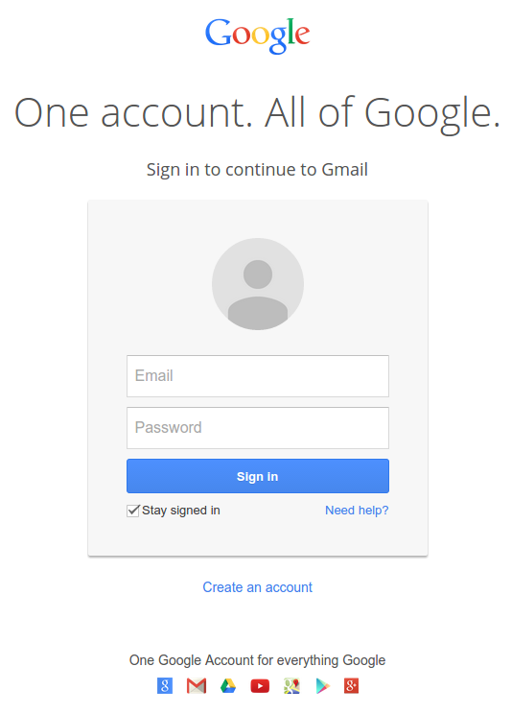
Passwords
Notes:
----- Meeting Notes (10/19/16 12:22) -----
Brute force attacks using word lists - guessing
Stealing passwords through password recovery
Spoofing attack / Phishing attack (defenses)
Network eavesdropping
Keylogging
Offline attacks on password database /reuse

Slide 14
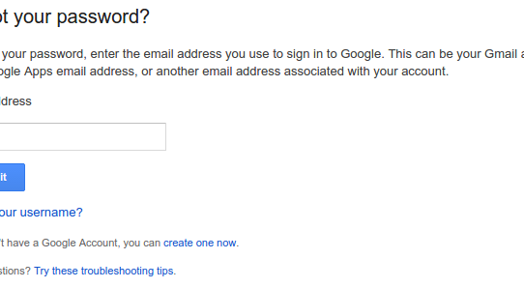
Usability Concerns
Notes:
Have to remember it
Have to enter it before access to the website, and not mistype it

Slide 15
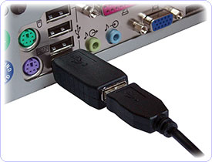
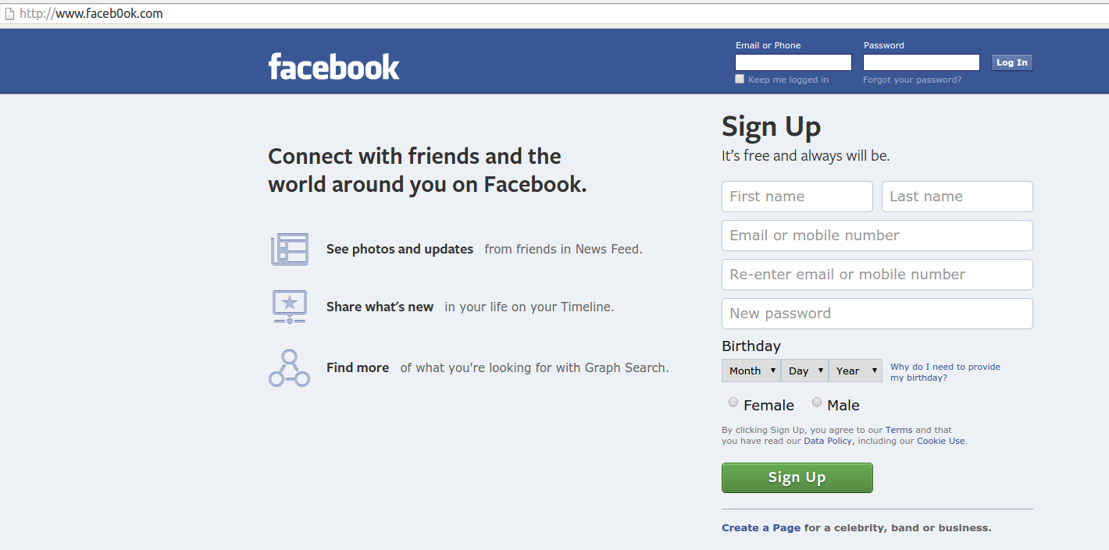
Stealing Passwords from the User
Key loggers (hardware, malware, shoulder surfing)
Phishing attacks
Network attacks
Notes:
----- Meeting Notes (10/19/16 12:22) -----
Post examples of phishing URLs

Slide 16
Social Engineering
Just ask the user!
Typical tactic: pretend you’re a system administrator

Slide 17
Phishing/Spoofing
Phishing:
pretend to be some other site/entity
get user to enter credentials
Spoofing:
make fake UI look like trusted login UI
Notes:
Phishing (like many hacking terms) is a lame misspelling of another word, in this case fishing -- give the user some bait.

Slide 18
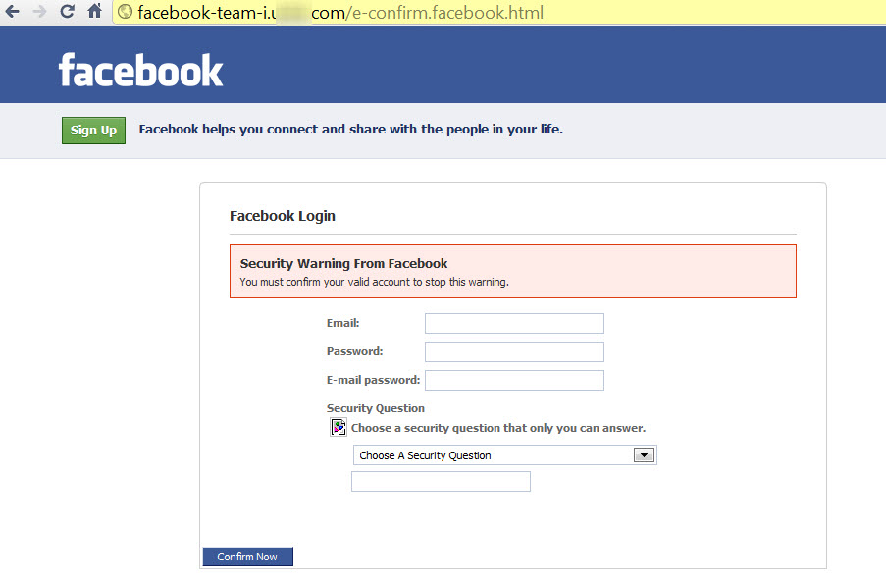
Notes:
Image credit: http://dataprotectioncenter.com/security/avoiding-facebook-phishing/

Slide 19
User Education
Confirm site/server before entering password
Tell users “Bank.com will never send emails asking for your password”
Notes:
We’ll see a bunch of defenses to the seven categories of attack. Defense i corresponds to attack i.

Slide 20
Making PKI More Usable
Current methods fall far short:
most users don’t notice security indicators/read URLs
Has the right logo? Probably the right site!
paypal.secure.com vs secure.paypal.com
User education unlikely to ever work here
Notes:
http://www.usablesecurity.org/emperor/emperor.pdf The Emperor's New Security Indicators --- 2007 paper
In study, 0 of 63 users noticed that HTTPS indicators were missing when visiting secure site
paypal.secure.com is owned by secure.com, has no connection to paypal.
Need to read domain names right-to-left.
It’s unlikely that typical users will ever have this level of security knowledge

Slide 21
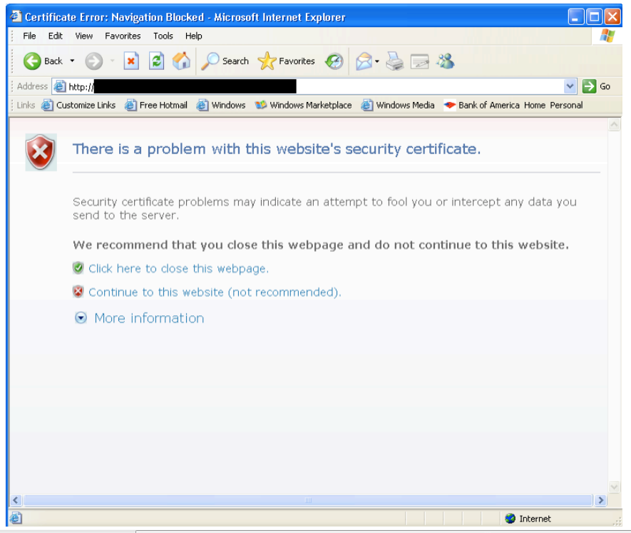
Ignored by about half of users!
Notes:
From same paper
Browser vendors have been working diligently to gradually improve these warnings using A/B testing, but there are fundamental limits

Slide 22
Blacklist Phishing URLs
e.g., Google safe browsing API
Will see in detail in web security lecture
Notes:
The browser blacklists known phishing URLs, making things even easier for the user.

Slide 23
Unspoofable UI
This can get tricky
Discussion: how would you defend against
Rogue program spoofs OS login screen
Rogue web page goes full-screen, spoofs browser window + FB login page in that window
Windows: Ctrl + Alt + Del gives control to the OS
Chrome tells you when you go full screen
Notes:
Are there such defenses in other OSes or browsers? Not sure, not to my knowledge.

Slide 24
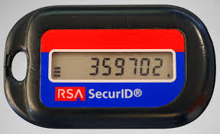
Never Type the Same Password Twice
Change the authentication protocol
“What you have” instead of “what you know”
RSA SecurID: code changes every minute
Homework: how to implement using symmetric crypto? using asymmetric crypto?
The company, not the algorithm
Notes:
SecurID is a hardware token, small device that a user carries around for authentication. Not Internet-connected.
One (symmetric) solution:
password = PRF_k(time)
k is a shared secret between the device and the server
-----------------
An OTP scheme has two crucial properties. First, its output must be effectively non- repeating. By 􏱘effectively􏱙 I mean that the odds of a repetition should be no greater than would occur by chance. Thus, if a single-use password Pi is drawn from the closed
interval [0,n 􏱡 1], the probability that Pi 􏱢 {P0,P1,...,Pn􏱡1} should be approximately 1/n. Second, seeing some set of values should not allow an adversary to predict future values.
That is, no matter how many Px the adversary has seen, the odds of a successful guess at Pi should remain no better than 1/n. Note that this property rules out the use of a secret
permutation of [0,n 􏱡 1] as the sequence of OTPs, though we could do it if we relax our condition to say that the probability of a successful guess must merely be less than some suitably small 􏱣 and i n.
In practice, OTP schemes generally depend on a strong cryptographic function and a secret. Thus, the SecurID tokens display F(K,T) where T is the time. (The scheme is actually rather more complicated than that; for my purposes, this simplification will suffice.) An adversary who could invert F􏱗 (today, AES is used) 􏱗could recover K and thus generate responses. There are two obstacles. First, if F is strong (and AES is believed to be) the attacker won􏱚t be able to invert it, especially with the limited number of samples
available compared with encrypted traffic. Second, for purely pragmatic reasons the output of F is often truncated. Thus, the display of a SecurID is generally capped at six digits, or about 20 bits, leaving 108 bits of the output of the AES encryption unknown.
Even if you could find K for one particular value of those bits, you don􏱚t know that that value is actually the one that the actual token􏱚s calculation produced; there are, after all, 2108 􏱡 1 other possibilities. Did you find the right K for the next T?
The same analysis holds true for typical challenge/response OTPs. In those, the server sends the client some random value N; the client (who is assumed to have a secure computing device) responds with F(K,N). As before, F is hard to invert and only a truncated form of its output is transmitted.

Slide 25
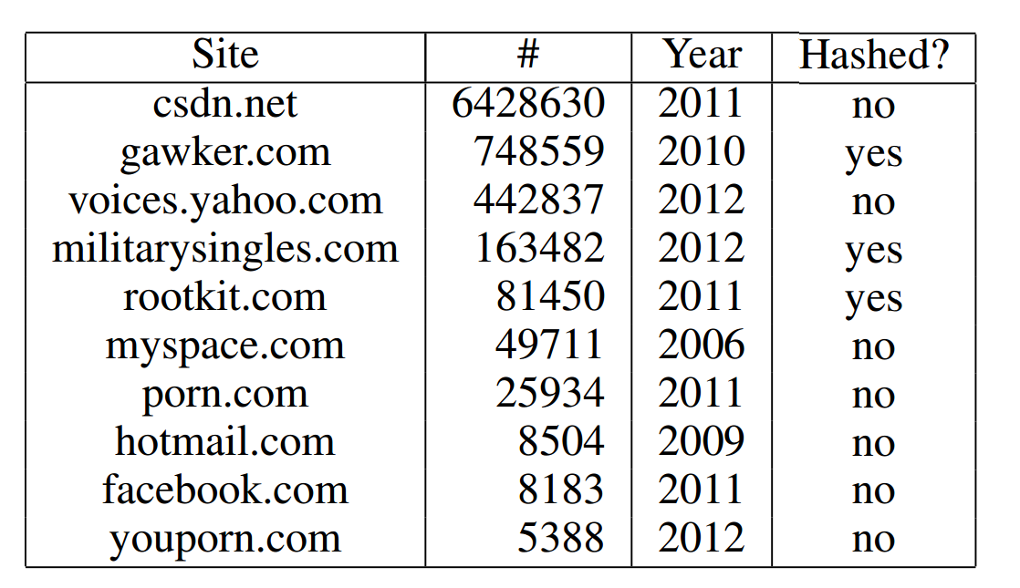
Stealing Passwords from the Website
Malware on website
Database dump (SQL Injection, shell injection)

Slide 26

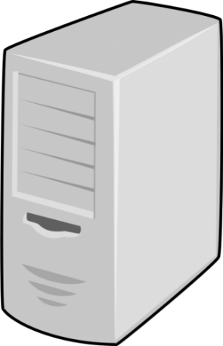

Different Passwords for Different Sites
domain.com
H(domain, password)
password
Advantages
No change to server side
Even if user is fooled by phishing domain, browser won’t be
Protects against password reuse
Disadvantages: usability
Need the tool on all devices
Need to abide server password rules
Remember which sites you used it on
Notes:
Browser extension (e.g., password manager) replaces the password field on the form with H(domain, password) before sending to server.
As far as server is concerned, H(domain, password) is the user’s password.
You need the same (or compatible) password manager on all devices.
There are other models for password managers: pick a random password for each site, encrypt site passwords with a master password. Sync the user’s encrypted DB with a cloud backend.

Slide 27
Violating User’s Physical Space
Shoulder surfing
Access copy of password written down by user
Reflection of typed password in glasses
Notes:
Shoulder surfing = looking over their shoulder (or some variant).

Slide 28
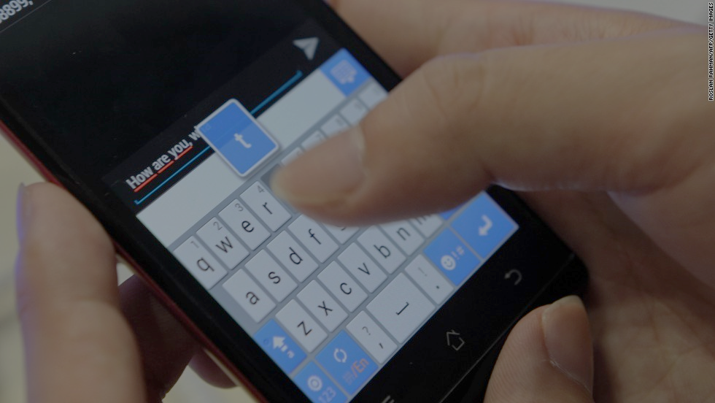
Exploit “key pop-out” to reconstruct text from a distance
Notes:
Some CSI-style techniques for shoulder surfing have been explored in research papers
iSpy: Automatic Reconstruction of Typed Input from Compromising Reflections
https://cs.unc.edu/~rraguram/papers/CCS2011.pdf

Slide 29
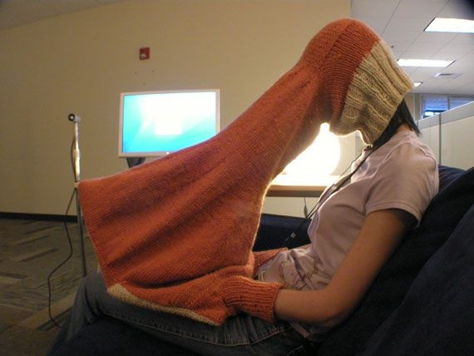
Prevent Shoulder Surfing
Notes:
Not a whole lot you can do about shoulder surfing.
Low hanging fruit: screen protector, don’t display passwords on screen.

Slide 30
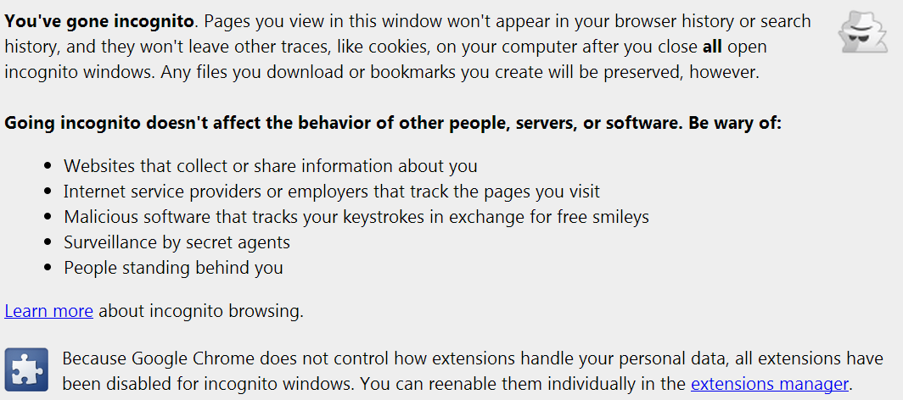
User Education
Notes:
From Chrome, 2013 version, no longer present.

Slide 31
Device Compromise
Malware on computer logs keystrokes
More generally, insecure (e.g., lost) device

Slide 32
Better Device Security
Don’t lose your device
Protect against malware
Remote locking feature
Notes:
Apple’s remote lock feature: https://support.apple.com/kb/PH2700?locale=en_US

Slide 33
On-line Guessing
Attacker tries password guesses one-by-one
Notes:
On-line because it’s via the actual password login interface.

Slide 34
Password Guessing Strategies
Brute force (‘aaaaa’, ‘aaaab’, …)
“Dictionary” or list of words in order of popularity
Generate alphanumeric strings using Markov model
Exploit personal information of victim
Notes:
Other options:
* lists of previously leaked passwords
* “mangling rules” to generate variants of passwords such as “add a digit at the end”
* hybrids of any of these.

Slide 35
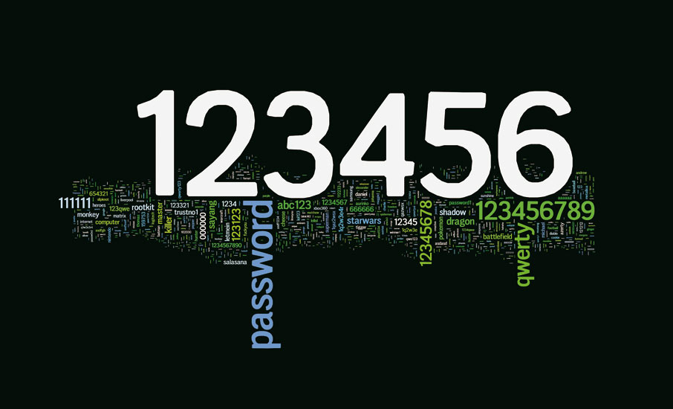
Guessing Common Passwords

Slide 36
Guessing of Passwords/PINs
PIN | Frequency
1234 | 10.713%
1111 | 6.016%
0000 | 1.881%
1212 | 1.197%
7777 | 0.745%
1004 | 0.616%
2000 | 0.613%
4444 | 0.526%
2222 | 0.516%
6969 | 0.512%
9999 | 0.451%
3333 | 0.419%
5555 | 0.395%
6666 | 0.391%
1122 | 0.366%
1313 | 0.304%
8888 | 0.303%
4321 | 0.293%
2001 | 0.290%
1010 | 0.285%
Notes:
Online attacks:
Detectable, shut off after n attempts, longer timeouts each incorrect guess, etc.
Potential denial of service

Slide 37
Rate-limit Login Attempts
Lock user out after some number of failed attempts
Problem: Denial-of-service attack Fix: rate-limit based on IP address, not username
Notes:
Usability drawback: user having trouble remembering password can get locked out.
Denial of service attack: adversary can try can lock you out.
Spoofing IP is certainly possible, but hard. “Device fingerprinting” is a more robust technique for identifying the attacker’s machine. We’ll look at it in the web security lecture.

Slide 38
Stronger Passwords
User education?
Password rules?
Password strength meter?
Only modest impact in practice
Stronger passwords less memorable
Notes:
Always usability into account when designing authentication.

Slide 39
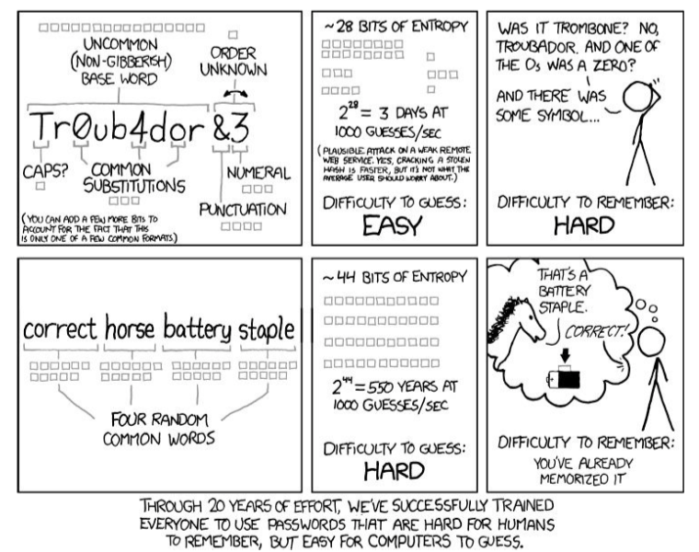
Password Strength and Mnemonics

Slide 40
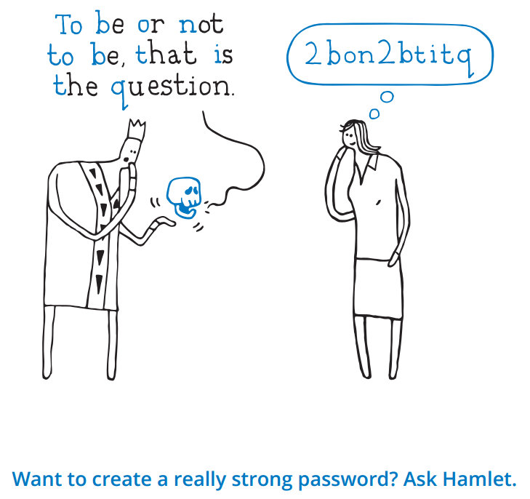
Strong and memorable passwords with simple mnemonics?
Notes:
This advice is given by Google. Here’s why it’s wrong http://www.lightbluetouchpaper.org/2011/11/08/want-to-create-a-really-strong-password-dont-ask-google/
Security problem: attacker can crawl every sentence on the web to generate candidate passwords.
Usability problem: the many possible variants due to letter/number substitutions can make it hard to memorize
(The above blog post recommends xkcd’s advice instead, but other research has shown that that’s not so great either https://www.ece.cmu.edu/~lbauer/papers/2012/soups2012-passphrases.pdf)
Bottom line: there’s no easy way around the security/memorability trade-off

Slide 41
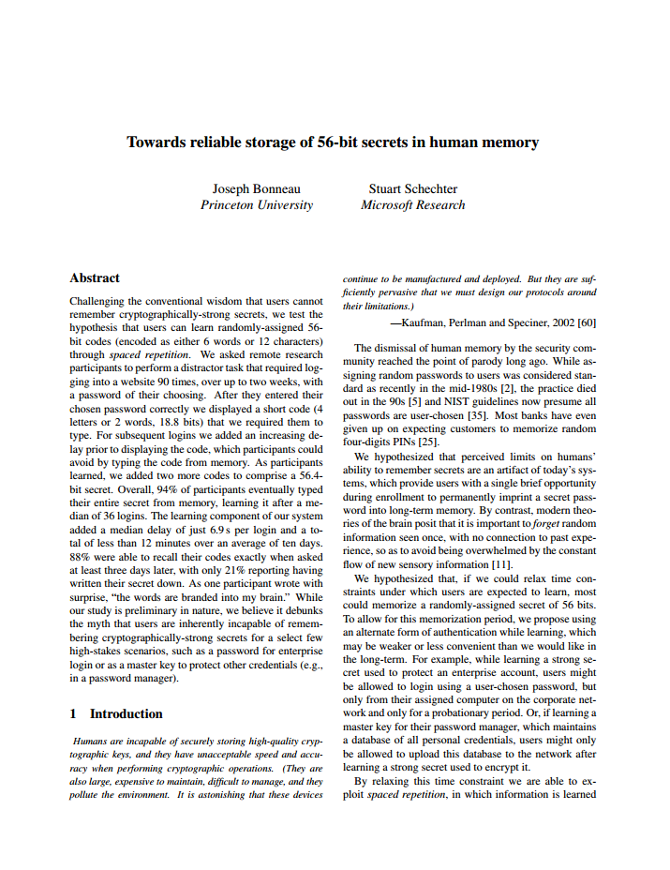
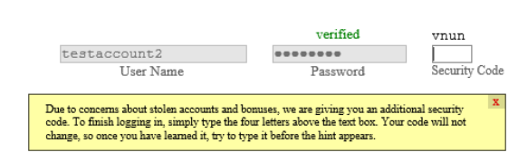
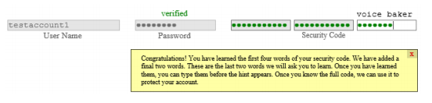
Users can memorize long passwords

Slide 42
Stealing from Password Databases (“Offline Attacks”)
Server must be able to authenticate users
Could store username/password in database
Better solutions?
Notes:
Password should be hashed

Slide 43
Stealing the Password Database
Unlike previous attacks, gets all passwords at once

Slide 44
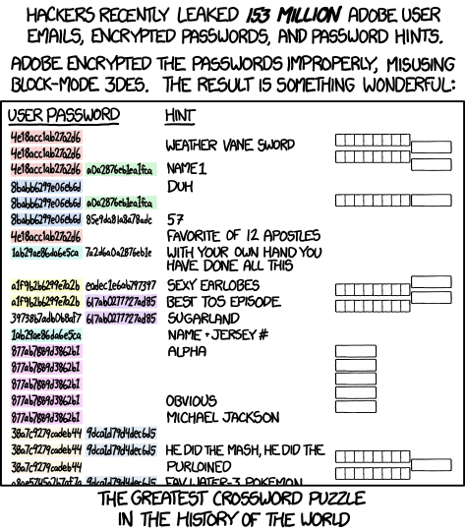
Hacking Password Databases

Slide 45
Password Guessing Rates
Suppose 150,000 guesses per second
1,000 node botnet
All eight-lowercase passwords: 30 minutes
Including digits: 5.5 hours

Slide 46
Password Hashing
Simple:
store H(Password)
Attacks?
Notes:
Brute force attacks, especially over common passwords

Slide 47
Store Hashed Passwords
Registration:
Store <username, Hash(pwd)>
Login:
Client sends <username, pwd’>
Verify if Hash(pwd’) matches Hash(pwd)
Notes:
With hashed passwords intrusion doesn’t immediately reveal passwords, but an offline dictionary attack is a big worry.

Slide 48
Recall: password guessing strategies
Brute force (‘aaaaa’, ‘aaaab’, …)
“Dictionary” or list of words in order of popularity
Generate alphanumeric strings using Markov model
Exploit personal information of victim
Notes:
Offline password guessing much more powerful attack model than online password guessing.
Example: 25-GPU cluster, 350 billion guesses per second https://securityledger.com/2012/12/new-25-gpu-monster-devours-passwords-in-seconds/

Slide 49
Salting Passwords
Enrollment
Generate random 64-bit “salt” s
Store <username, s, Hash(s, pwd)>
Login
Receive <username, pwd’>
Look up s and hash based on username
Test if Hash(s, pwd’) == Hash(s, pwd)
Notes:
Discussion: this mitigates two related attacks. What are they?

Slide 50
Salting Stops Precomputation
Precomputation:
Compute the hashes of possible passwords ahead of time
When server breached, simply look up
Salting ensures attacker must separately attack each password
Notes:
Without salting, the number of hash computations the attacker must perform is O(D + P) where D is the size of the dictionary or the password list that the attacker wants to use for guessing, and P is the number of passwords to crack.
With salting, it’s O(D times P).
Homework: verify this

Slide 51
Use a Slow Hash Function
If H is a fast hash function H^{N} is a slow(er) hash function
That’s H applied N times iteratively
Pick N = (say) 1 million so that it takes (say) 100ms to verify
Homework:
You picked N = 10⁶ years ago when you set up your website
Hardware’s faster now
Server’s verification time & attacker’s guessing time both lower
How can you increase N without asking users to re-login?
Notes:
Solution: let M = N_new – N_old
Apply H to each hashed password M times.

Slide 52
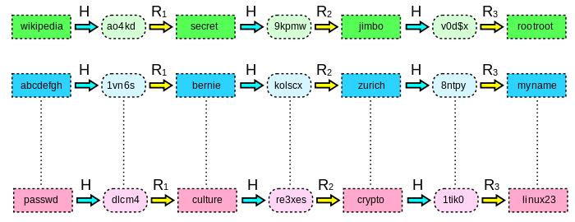
Rainbow Tables
Similar to a lookup table
Attacker(s) can trade-off disk-space vs. CPU time
Recovered 90% of 6.5M LinkedIn passwords in 6 days

Slide 53
Rainbow Table Defense
Good: salted hashes
Store H(Password + user-specific salt)
Better: slow hash functions
Bcrypt
Based off expensive key-setup of Blowfish
Scrypt
Requires large amounts of memory
Though can be traded off for CPU time
Cryptocurrencies have spurred ASIC implementations
Notes:
Salt your passwords

Slide 54
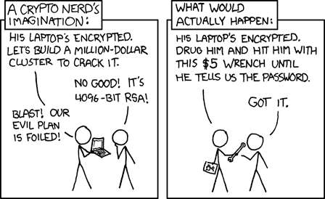

Slide 55
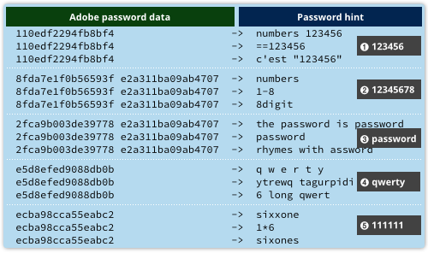
Stealing Passwords from Other Sites
Passwords commonly re-used across sites

Slide 56
Password Management

Slide 57
Password Recovery
Sometimes users forget passwords
Or are locked out!
Reset vs. Recovery
Have to authenticate – but how?
Notes:
Phone, (other?) email, something you know that the server also knows (facebook friends), security questions

Slide 58
Clever password recovery procedures
Always email-notify user
After successful recovery, lock user out for a while. Real user may log in and notice!
If conflict, escalate
Notes:
The idea is not to prevent the attack but rather to make sure the user is notified.
Prevention is not always possible or desirable; detection and recovery could be a good way to go.
That’s what happens with credit card fraud. More on this soon.

Slide 59
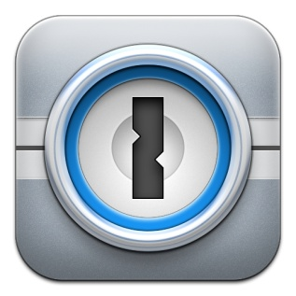


Password Managers
Store passwords
Generally encrypted under master password
Generate passwords
Allows easier unique passwords per site

Slide 60
Concerns with Password Managers
Encryption
Synchronization
Web authentication
External hardware

Slide 61
Possibilities
File on computer
USB drive
Cloud storage
Piece of paper
Dedicated password storage app

Slide 62

Network-Based Authentication
User sends password
Hopefully over encrypted channel (TLS/SSH)
Challenge-based authentication
Server sends challenge (nonce)
User sends response (H(password, nonce))
Kerberos

Slide 63
Conventional password wisdom is often wrong
Notes:
Example of conventional wisdom that we’re now rethinking: never write down your password.
In reality, depends on threat model; more often than not it’s fine to write it down, but make sure to keep it safe and secret yet easily available.

Slide 64
Traditional wisdom/myths
Emerging consensus
Passwords are dying
Vital to have long and complex passwords
Focus on offline attacks
All hope lost if password guessed
Replacements have worse problems
Beyond a point, doesn’t improve security that much
Focus on online attacks
Password is one of many factors
Notes:
Recall the infosuck vs. good enough distinction.
Joe Bonneau’s research has led to much of the re-thinking of the old beliefs. See for instance http://www.jbonneau.com/doc/BHOS15-CACM-imperfect_authentication.pdf
Observe that attacks #5 and #6 are the only two of the seven categories where password strength even matters! And #6 is the only category where resistance to offline attacks matters. Even in that case, for mitigating the consequences of a server compromise, minimizing reuse across sites is more effective than trying to prevent guessability. That’s the reason why crazy-strong passwords offer little security benefit over moderately strong passwords that resist online attacks.

Slide 65
Broad defense: don’t rely on passwords as sole authentication mechanism
Notes:
We’ll come back to this at the end. It’ll mitigate many of the attack categories.

Slide 66
Multi-factor authentication
Something you know, something you have, something you are

Slide 67
Machine Learning in Authentication
Inspiration:
Credit card system ineffective at secrecy
Yet fraud is acceptably low
Credit card no. / password is one of many signals
Use machine learning to detect anomalous use
Example from Google:
120 variables
300x fraud reduction compared to passwords alone

Slide 68
Test implicit signals, fall back to 2nd factor
Implicit signals
Second factors
Location
Device fingerprint
Analogous to unique device ID
User behavior
Time of login
Resources requested
Typing, mouse patterns
Possession of phone
Security questions
Hardware token
Advanced techniques
Progressive authentication,
continual authentication

Slide 69
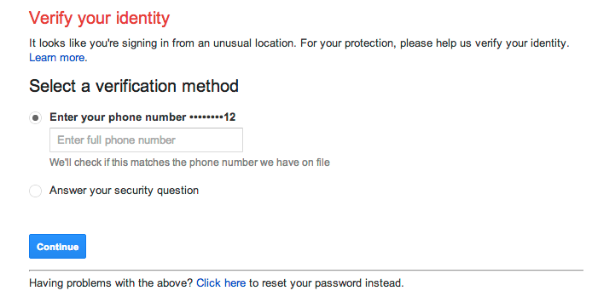
Fall back to second factor

Slide 70
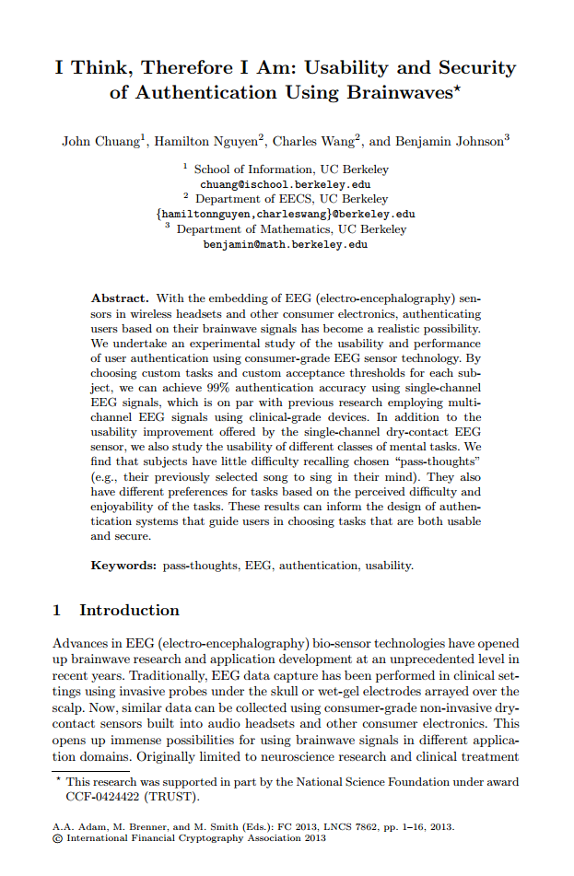
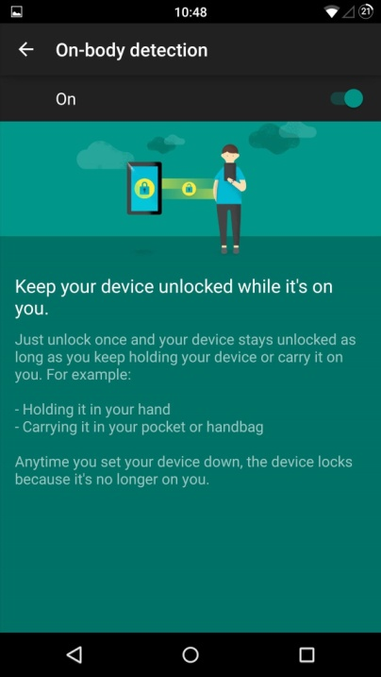
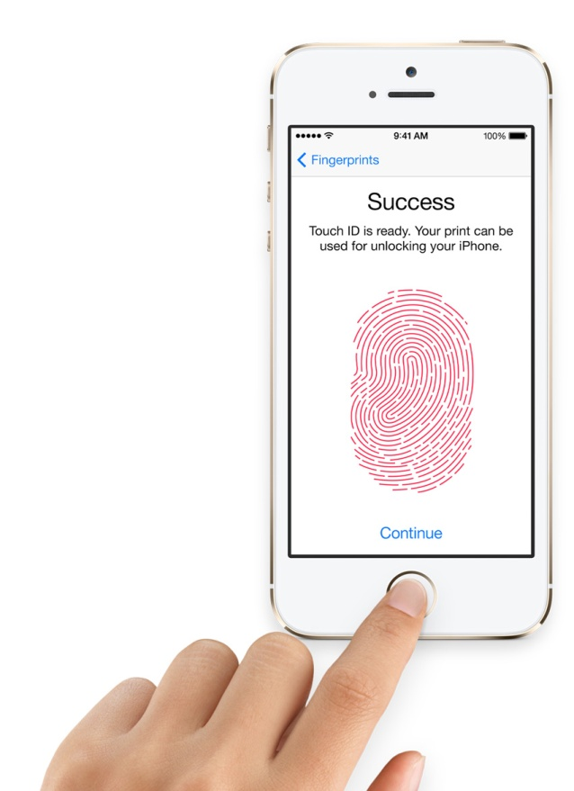
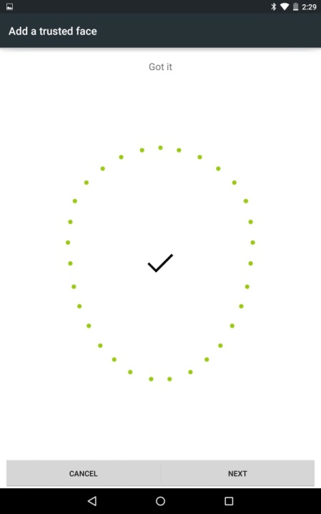
Future of authentication?
Notes:
Crazy ideas: use brainwaves to authenticate people without them “realizing it”
Using phones as single modes of authentication; now phone has to be authenticated. Pin? TouchID? Face recognition? On body-detection? Most of those broken (why? Pin reuse, predictable, touch id hack, face recognition fooled by picture, on body detection … not yet, but heuristic based (and fallback to pin?))
Interesting things from apple wrt pin login, store strong encryption key for device in Secure Enclave, and have secure enclave authenticate pin; can enforce lockout etc. brute force now not possible.

Slide 71
Biometric authentication?
Three things to remember
Biometrics aren’t secret
Biometrics aren’t secret
Biometrics aren’t secret
Preventing spoofing is hard
One solution: human in the loop
OK against casual adversaries (e.g., Touch ID)
Notes:
Biometrics derive their security not because the attacker can’t get the victim’s fingerprint (or other biometric) but because the system is supposed to be able to detect if the attacker presents a fake biometric.
Obvious corollary: biometrics useless for remote authentication
Apple TouchID is useful for securing your phone when leaving it on table when you go to use the bathroom. Casual attacker model. Always have to consider threat model. Attacker is not always foreign government, could be nosy neighbor.

Slide 72
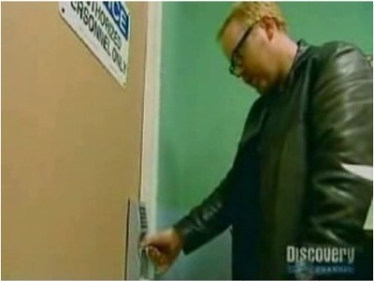
Preventing spoofing is hard
Busting the myth of biometric security?
Lock checks temperature, conductance
of putative finger
Defeated by licking fake fingertip
Notes:
http://blogs.technet.com/b/steriley/archive/2006/09/20/mythbusters-beat-_2200_unbreakable_2200_-fingerprint-door-lock.aspx
“Supposedly it monitors pulse, sweat, temperature, and other attributes. First, Adam obtains an impression of a fingerprint already present on the reader and creates a latex copy that he adheres to his own thumb. Initial attempts fail, but when Adam licks the latex, the door opens. Next, Jamie tries a ballistics gel copy of the fingerprint. Sure enough, the door opens right away. Adam remarks that some cheap computer fingerprint reader was actually more difficult to hack than the "unbreakable" door lock! Finally, Adam tries the simplest of all attacks: a photocopy of the authorized fingerprint. No warmth, no pulse, only a lick -- and again, the door opens.”

Slide 73
And now for something completely different: How to use passwords instead of PKI for authenticated key exchange

Slide 74

Recall: Diffie-Hellman Key Exchange
Fix large prime p, “generator” g
Pick random x
a = g^{x} % p
k_{Alice} = b^{x} % p
Pick random y
b = g^{y} % p
k_{Bob} = a^{y} % p
Puzzle:
Alice & Bob have a shared password.
Human users; no PKI
Can they authenticate their key exchange?

Slide 75
Password-Authenticated Key Exchange
Fix large prime p, “generator” g
Pick random x
a = g^{x} % p
k_{Alice} = b^{x} % p
Pick random y
b = g^{y} % p
k_{Bob} = a^{y} % p
Derive generator g from password: g = Hash(password) % p
Homework:
reason why this is vulnerable only to an online attack and not an offline attack
Notes:
I cheated a little – in fact g = H(password)^2 % p, for reasons we won’t go into
This particular protocol is called Simple Password Exponential Key Exchange. There are other PAKE protocols.

Slide 76
PKI (for sender)
Signature
Synchronous?
✘
PKI (for recv’r)
Asym. enc
Sym. enc
✓
✘
Need PFS?
PKI (for server)
RSA-KE (only client-server)
✓
Type of app?
Human-to-human
DHKE
Verify OOB
Client-server
PKI (for server)
PAKE
Auth. DHKE
How to
communicate
securely
Secure channel
Sym. enc
Shared secret key
User auth
(if client-server)
MAC
Notes:
Notes:
Previous map was about how to construct these things, this map is about which one to use in which scenario.
Asynchronous model: email is a typical example. Synchronous model: web browsing and SSH. Instant messaging can be either one, but is usually treated as synchronous.
In the asynchronous scenario you need both sender and receiver to have a public key (to get both confidentiality and authentication). Normal people aren’t interested in setting up public keys (much less using crypto correctly). That is why email encryption is currently an unsolved problem, and adoption is almost nonexistent (compared web encryption).
Homework: when you visit gmail.com it’s encrypted. So what am I talking about when I say email encryption is nonexistent? Which category does Gmail fall into in this map?
In human-to-human DHKE, out-of-band verification can happen in parallel after the secure channel has been set up. So when the channel is set up it’s at first an encrypted but unauthenticated channel.
Just about everything here relies on PKI (except PAKE and Out-Of-Band verification). User authentication and PKI are the Achilles’ heels of the whole system.
PFS = Perfect Forward Secrecy, aka just Forward Secrecy.
Asym. enc → Sym. enc refers to hybrid encryption --- generate random symmetric key, asymmetrically encrypt it, encrypt message with key.

Slide 77
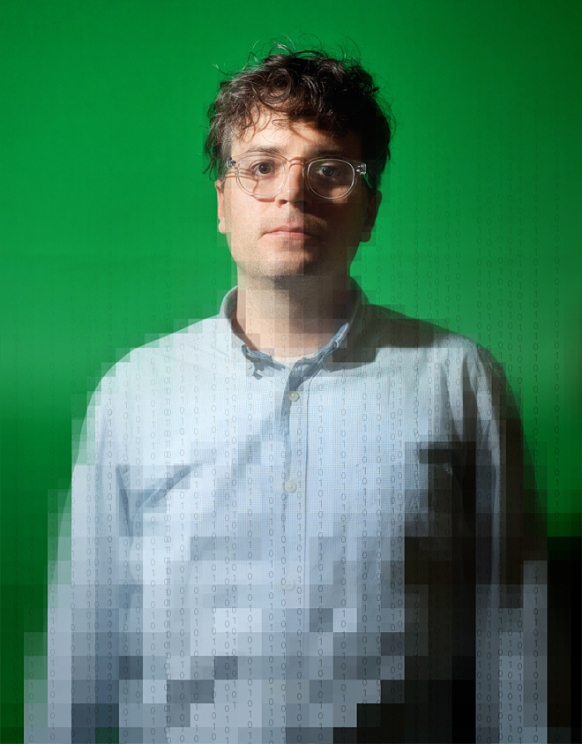




Password recovery gone wrong
Mat Honan Photo: Ariel Zambelich/Wired. Illustration: Ross Patton/Wired

